Slide 1


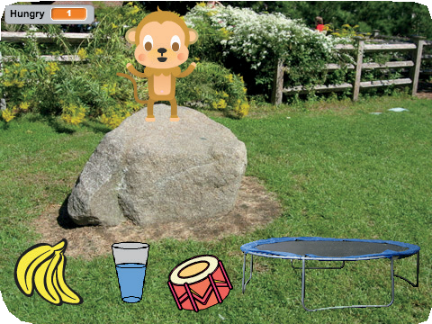
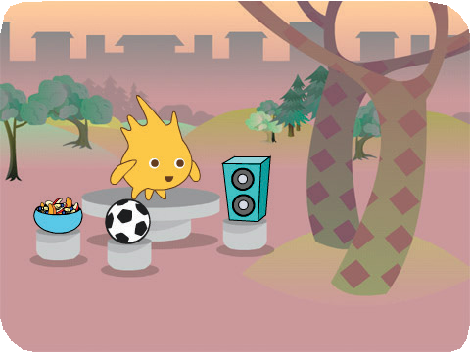
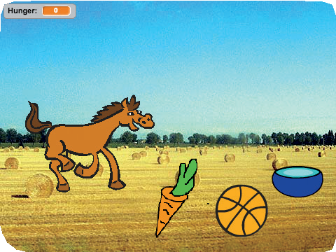
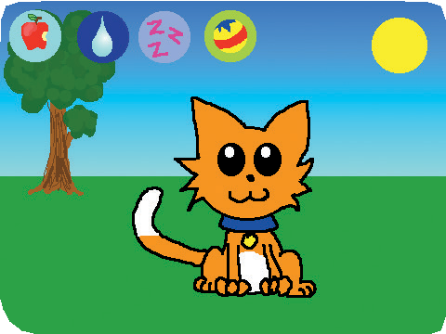

Virtual Pet
Virtual Pet 1
Cards
Create an interactive pet that can eat, drink, and play.
scratch.mit.edu/pet

Slide 2
Virtual Pet
Virtual Pet 2
Cards
Use these cards in this order:
Introduce Your Pet Animate Your Pet Feed Your Pet
Give Your Pet a Drink What Will It Say?
Time to Play How Hungry?
1
2
3
4
5
6
7
scratch.mit.edu/pet

Slide 3

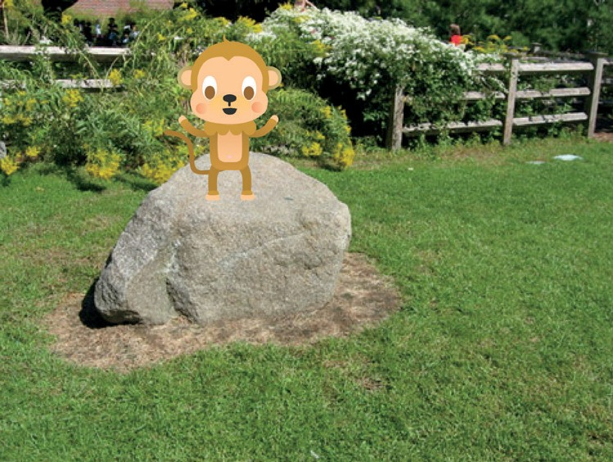
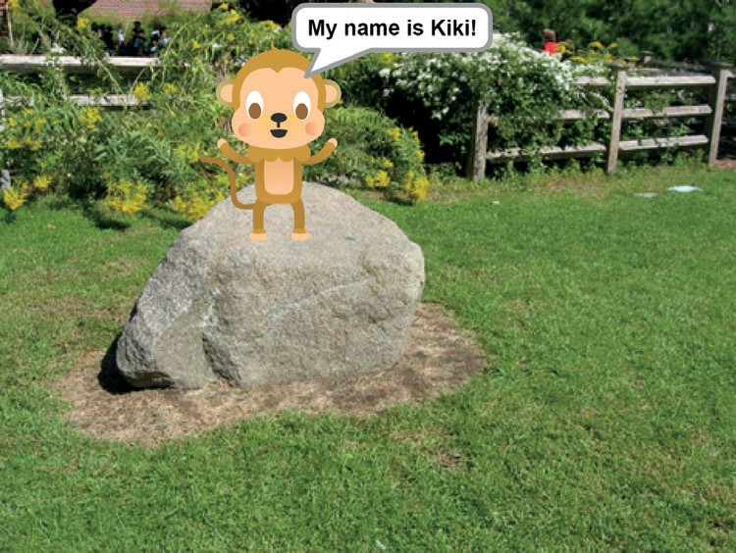
Introduce Your Pet
Choose a pet and have it say hello.
Virtual Pet
1

Slide 4





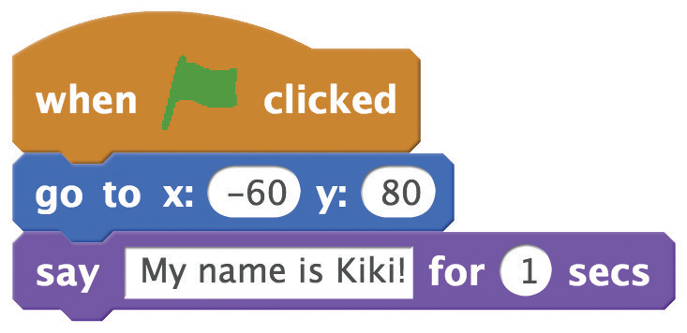

Introduce Your Pet
scratch.mit.edu/pet
GET READY
Choose a pet.
Choose a backdrop.
ADD THIS CODE
Drag your pet to where you want it on the Stage.
Set its position. (Your numbers may be different.)
Type what your pet will say.
TRY IT
Click the green flag to start.

Slide 5


Animate Your Pet
Bring your pet to life.
Virtual Pet
2

Slide 6


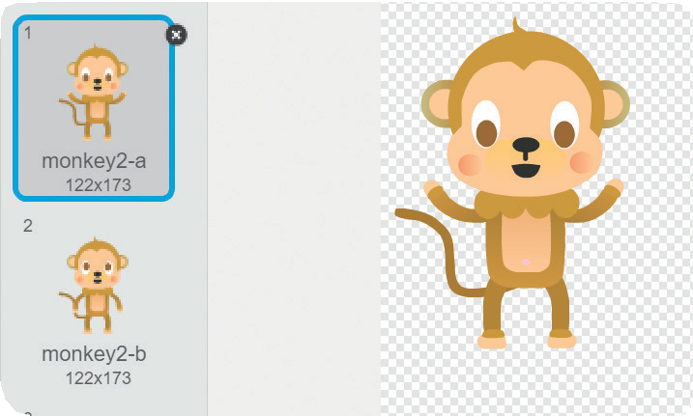

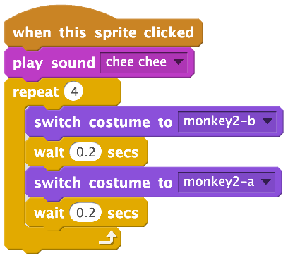
Animate Your Pet
scratch.mit.edu/pet
GET READY
Click the
tab to see your pet’s costumes.
ADD THIS CODE
Click the tab.
Choose a costume.
Choose a different
costume.
TRY IT
Click your pet to start.

Slide 7
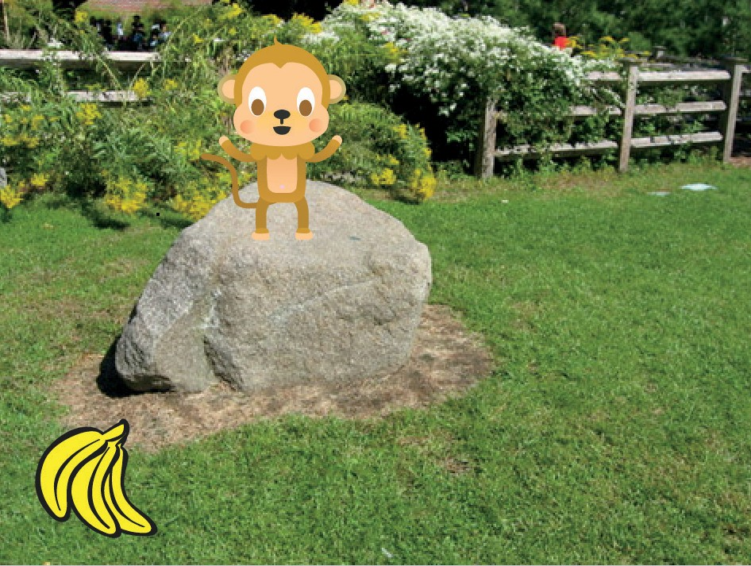
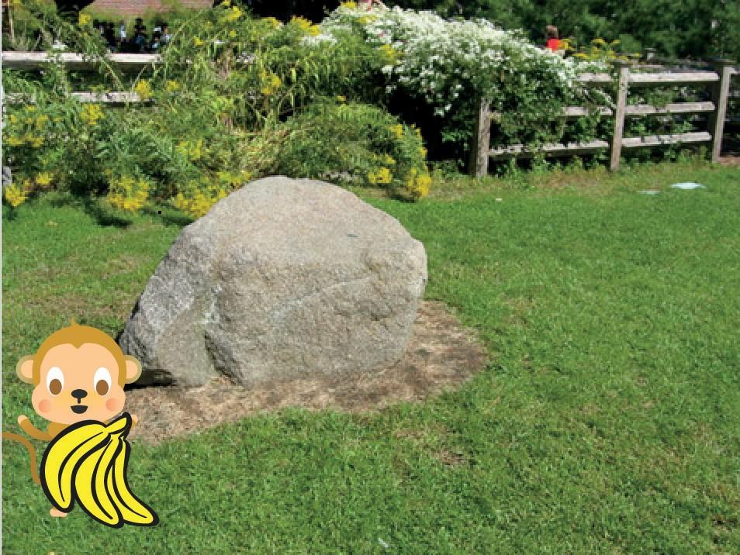
Feed Your Pet
Click the food to feed your pet.
Virtual Pet
3

Slide 8






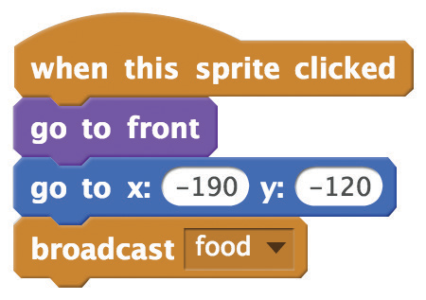
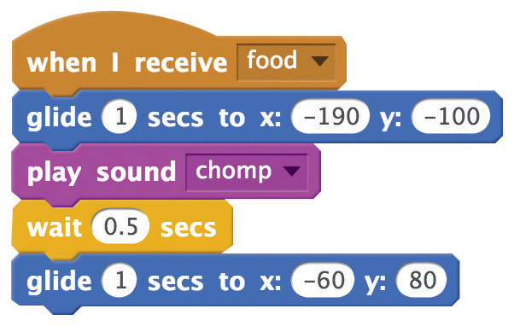
Feed Your Pet
scratch.mit.edu/pet
GET READY
Click the
tab.
Choose a food sprite.
Choose a sound from the Sound library, like chomp.
ADD THIS CODE
Select a new message
and name it food.
Broadcast the food message.
Tell your pet what to do when it receives the message.
Glide to the food.
Glide back.
TRY IT
Click the food to start.

Slide 9
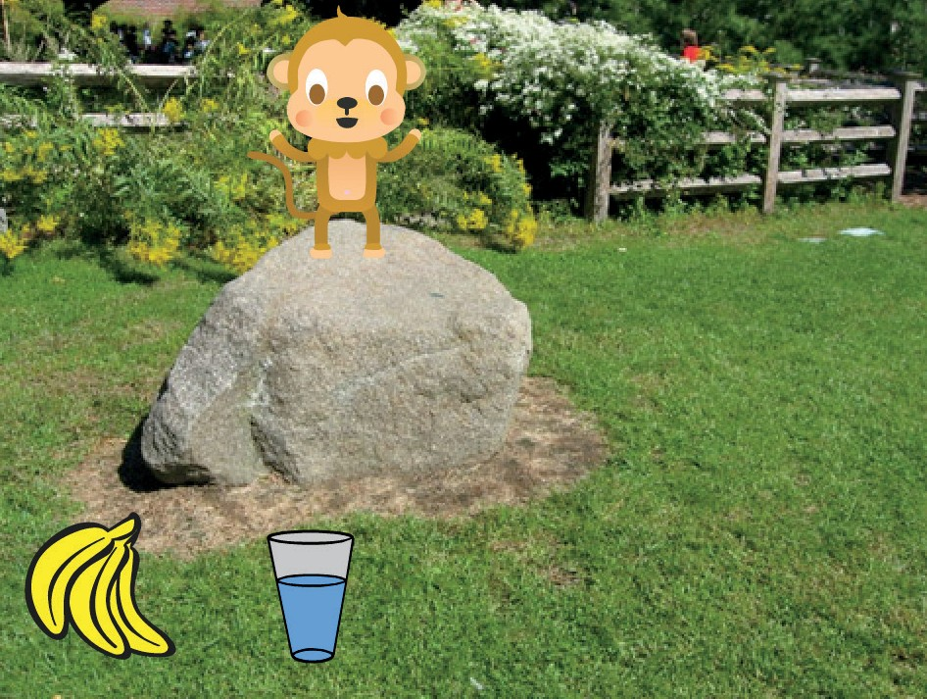
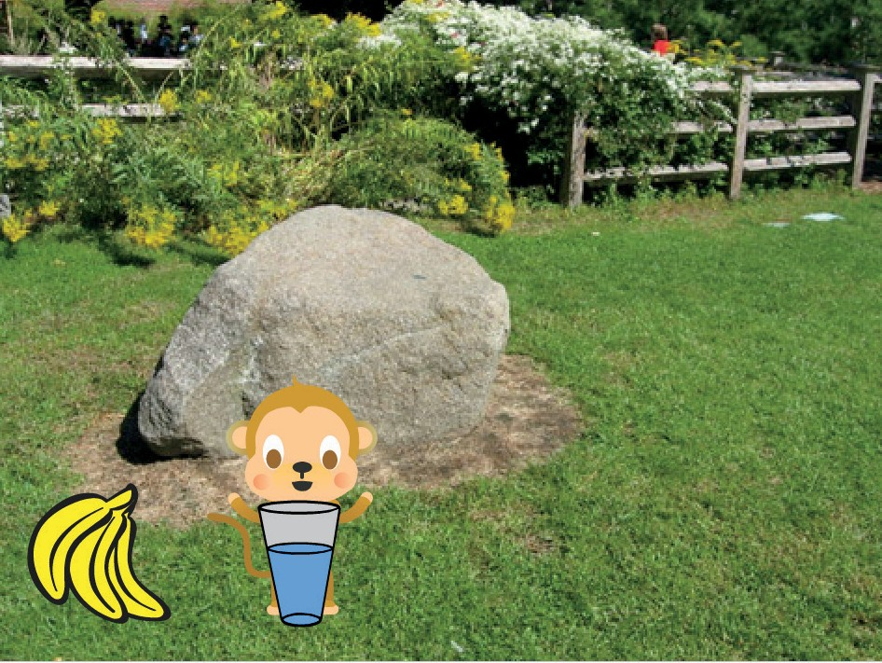
Give Your Pet a Drink
Give your pet some water to drink.
Virtual Pet
4

Slide 10


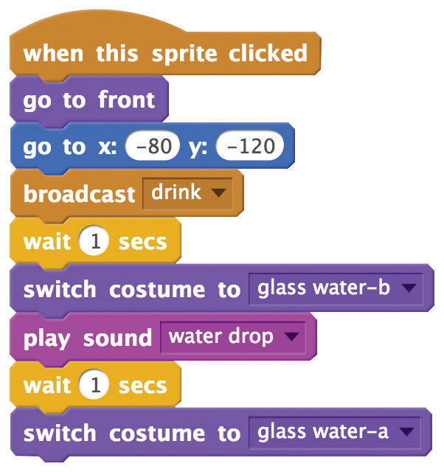

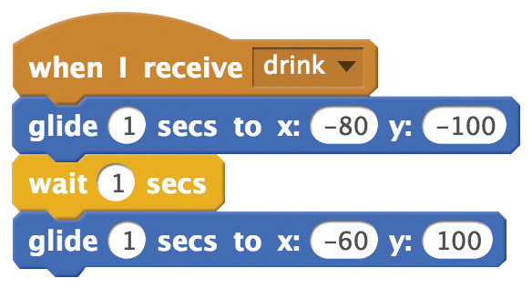
Give Your Pet a Drink
scratch.mit.edu/pet
GET READY
Choose a drink sprite, like Glass Water.
ADD THIS CODE
Broadcast a new message.
Switch to the empty glass.
Switch to the full glass.
Tell your pet what to do when it receives the message.
Glide to the drink.
Glide back.
TRY IT
Click the drink to start.

Slide 11
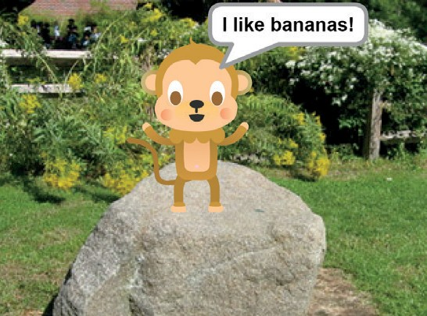
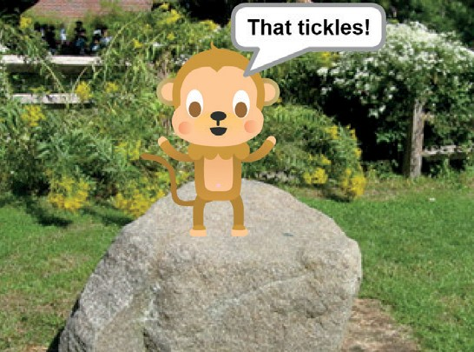
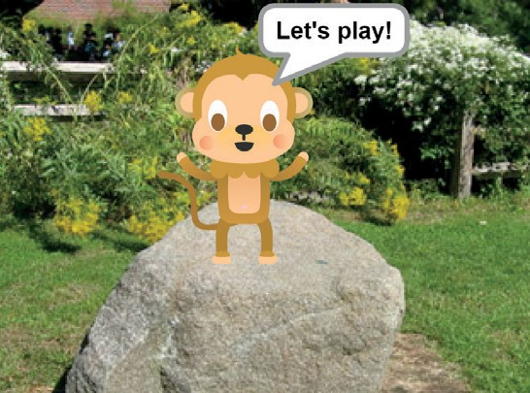
What Will It Say?
Let your pet choose what it will say.
Virtual Pet
5

Slide 12
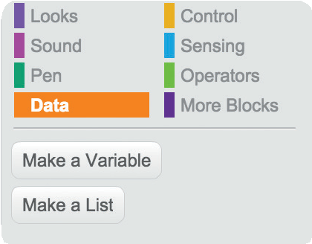
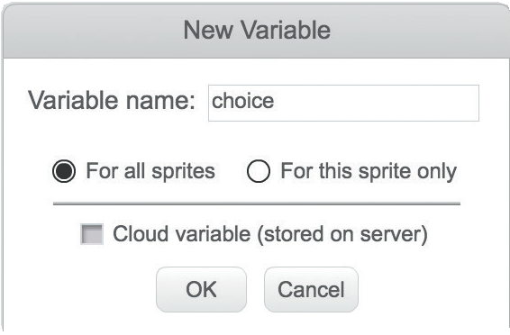
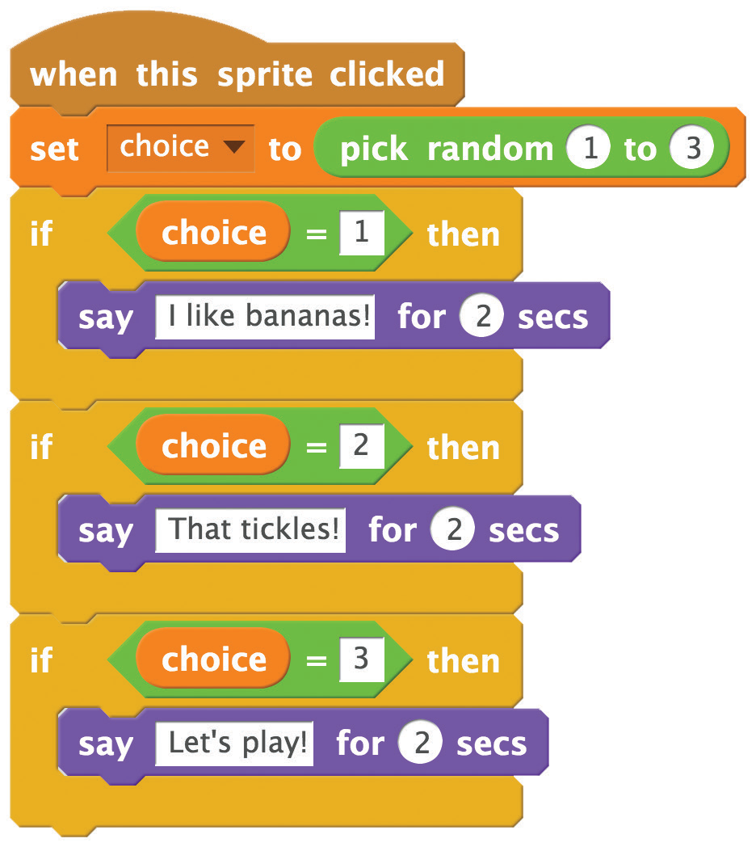
What Will It Say?
scratch.mit.edu/pet
GET READY
Choose Data.
Click the Make a Variable button.
Name this variable choice
and then click OK.
ADD THIS CODE
Insert the pick random block.
Insert the choice block.
Type what you want your pet to say.
TRY IT
Click your pet to see what it says.

Slide 13
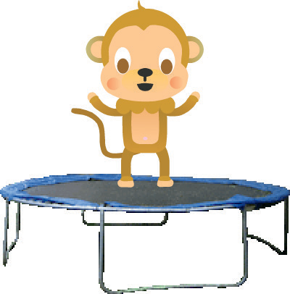
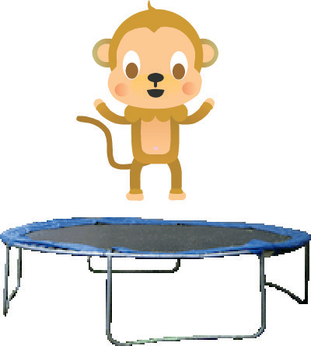
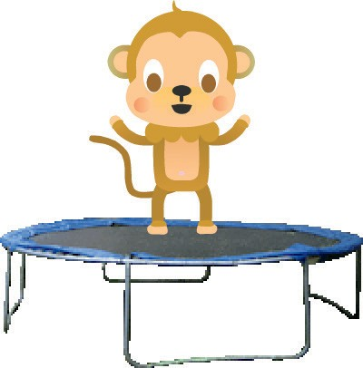
Time to Play
Have your pet jump on a trampoline.
Virtual Pet
6

Slide 14
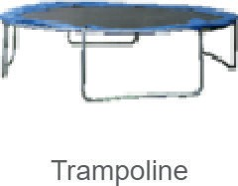
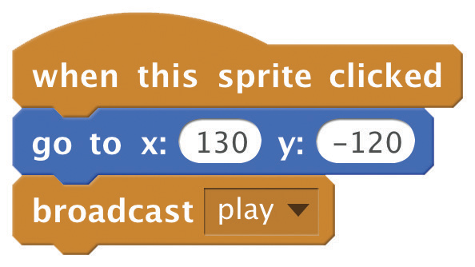
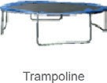
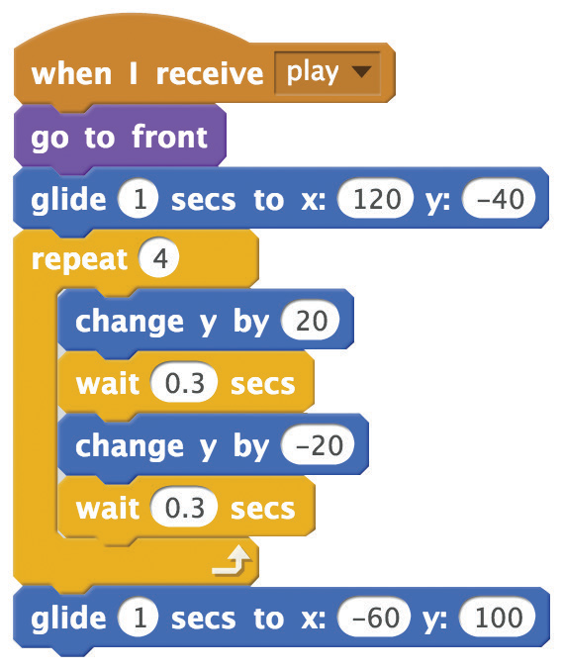
Time to Play
scratch.mit.edu/pet
GET READY
Choose the Trampoline.
ADD THIS CODE
A positive number makes your pet jump up.
A negative number brings your pet back down.
TRY IT
Click the trampoline.

Slide 15
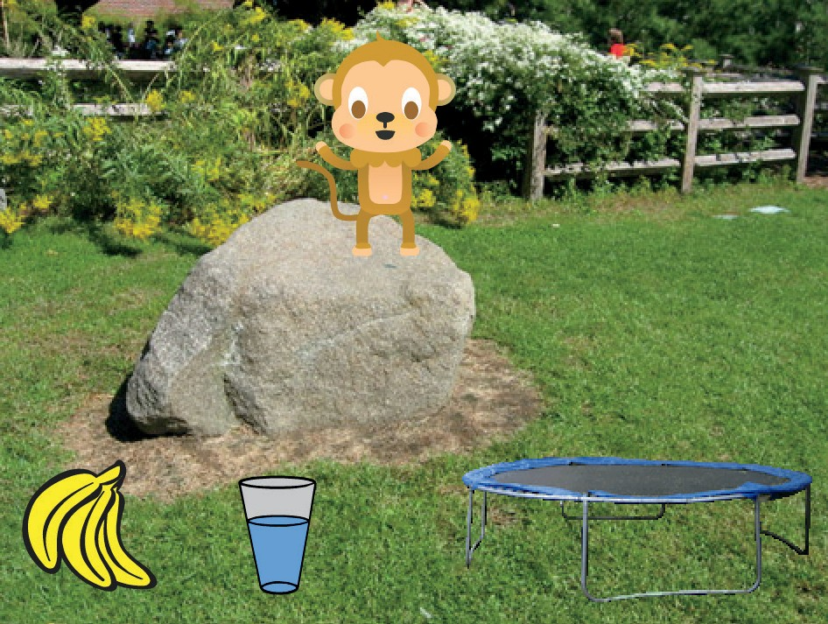

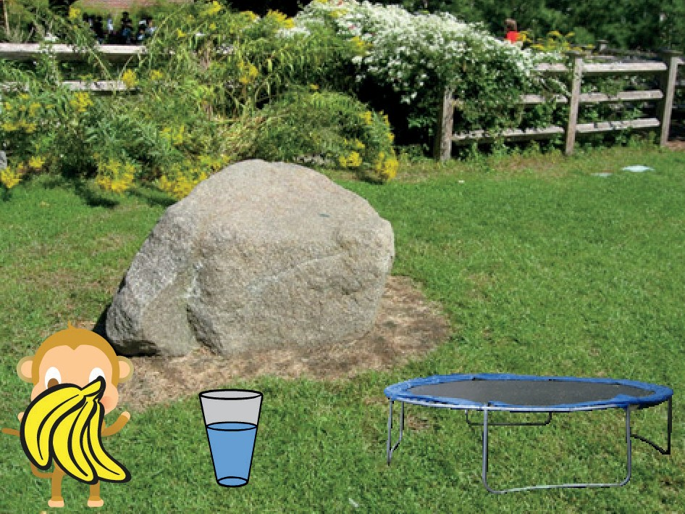

How Hungry?
Keep track of how hungry your pet is.
Virtual Pet
7

Slide 16

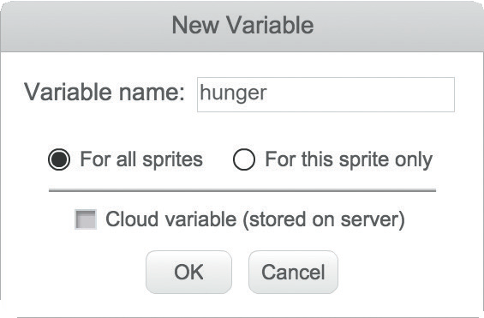
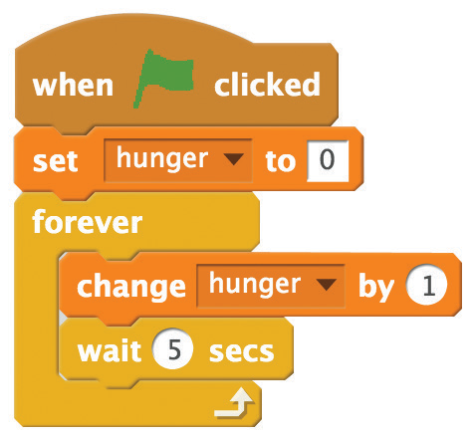
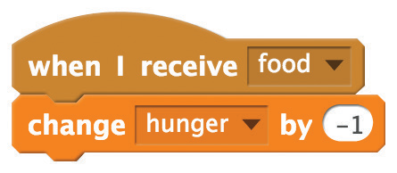


How Hungry?
scratch.mit.edu/pet
GET READY
First, add food using the Feed Your Pet card. Then, click to select your pet.
Choose Data.
Click the Make a Variable button.
Name this variable hunger
and then click OK.
ADD THIS CODE
Reset hunger level.
Type a negative number to make your pet less hungry.
Increase hunger level.
TRY IT
Click the green
flag to start.
Then click the food.

